Slide 1
“STEGANOGRAPHY”
CAPSTONE PROJECT
Presented By:
Student Name : Rishabh Gupta
College Name & Department : Kiet group of institutions & Computer science and engineering

Slide 2
OUTLINE
Problem Statement
Technology used
Wow factor
End users
Result
Conclusion
Git-hub Link
Future scope

Slide 3
Problem Statement
Context: Secure communication is critical as cyber threats rise, but encryption often exposes sensitive data to attackers.
Problem: Existing steganography methods have low capacity, visible distortions, and are prone to detection, limiting covert communication.
Objective: This project aims to enhance steganography by improving data embedding, maintaining imperceptibility, and increasing resistance to steganalysis.

Slide 4
Technology used
1 . Programming Language : “python”
2. Libraries : ”open CV for image processing ,TKINTER (with ttk) for the GUI ,
NUMPY for efficient array manipulation”
3 . Platform : “cross-platform (Window /Linux)”
4 . Tools : “visual studio code”

Slide 5
Wow factors
Implements robust LSB steganography that embeds both the passcode and message length in the image header.
Uses lossless PNG format to preserve hidden data integrity.
Features a modern, user-friendly GUI for both encryption and decryption processes.
Combines advanced image processing techniques with secure data transmission

Slide 6
End users
Security professionals and cybersecurity enthusiasts.
Journalists, activists, and government agencies needing secure communication channels.
Students and researchers interested in data privacy and steganography.
General users looking for enhanced digital security

Slide 7
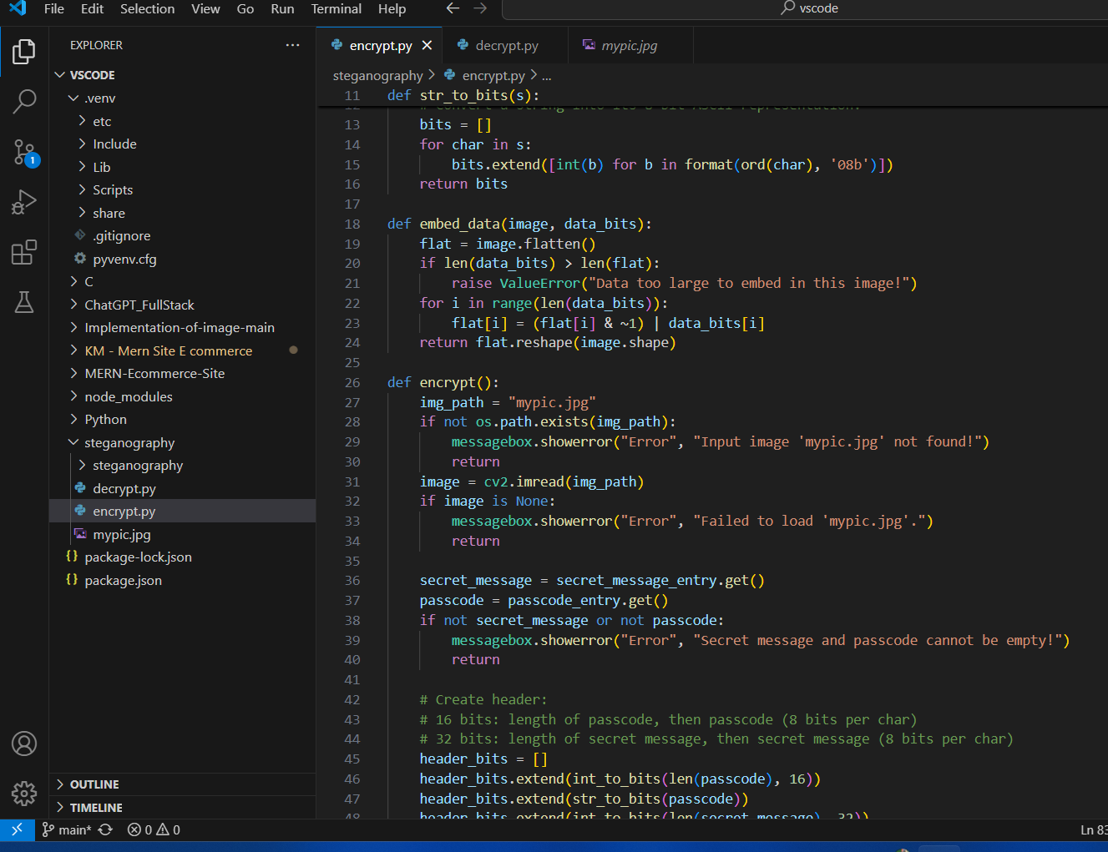
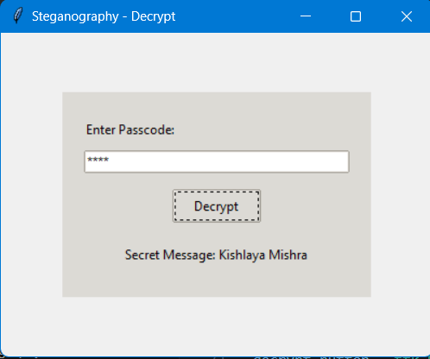
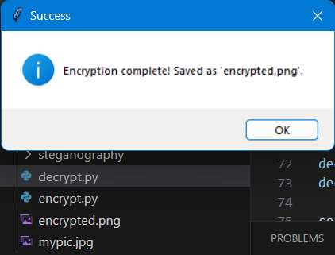
Results

Slide 8
Conclusion
Our project successfully demonstrates a novel approach to data security by hiding information within an image using LSB steganography.
The technique is both secure and undetectable, thanks to embedding critical header information such as passcode and message lengths.
The user-friendly GUI enhances the accessibility of the method, making it a practical tool for secure communication.
This project contributes to the broader field of digital privacy and secure data transmission

Slide 9
GitHub Link
https://github.com/rishabhgupta116/my_project_2.git

Slide 10
Future scope(optional)
Support for multiple image formats and higher resolution images.
Extend the approach to video steganography for dynamic data hiding.
Incorporate advanced encryption algorithms to further secure the hidden message.
Develop a web-based or mobile application for broader accessibility.
Explore automated detection and extraction tools for steganographic content

Slide 11
THANKYOU

